Slide 1

Questions
Group 670

Slide 2
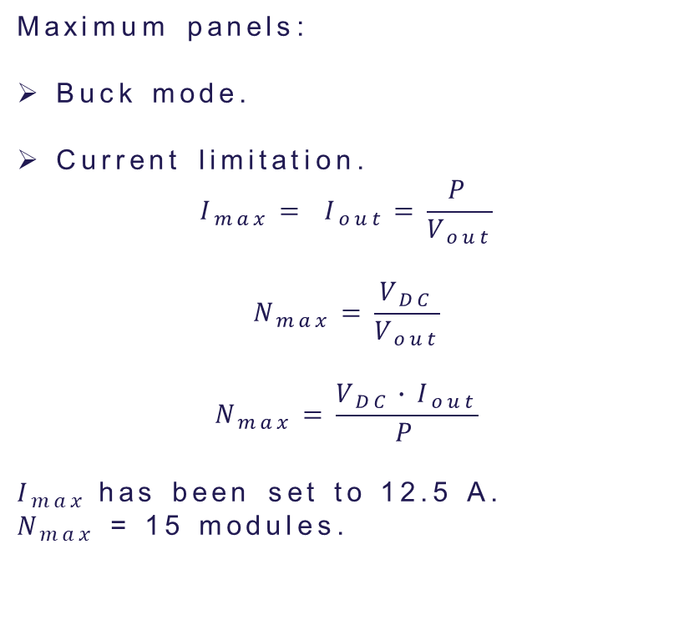
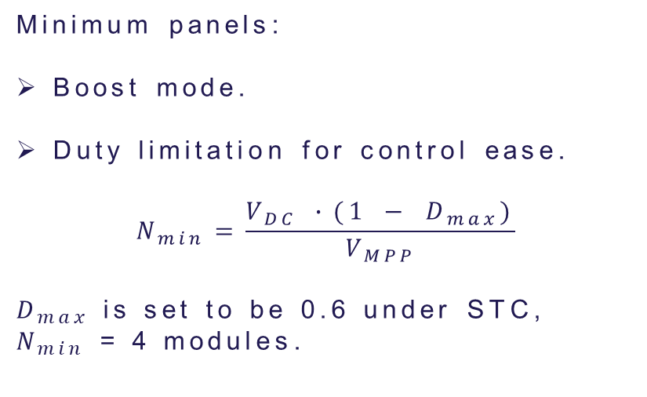
Minimum and maximum number of panels
Maximum panels:
Buck mode.
Current limitation.
$$I_{max}= I_{out}=\frac{P}{V_{out}}$$
$$N_{max}=\frac{V_{DC}}{V_{out}}$$
$$N_{max}=\frac{V_{DC}∙I_{out}}{P}$$
$I_{max}$has been set to 12.5 A.
$N_{max}$ = 15 modules.
Minimum panels:
Boost mode.
Duty limitation for control ease.
$$N_{min}=\frac{V_{DC} ∙(1 − D_{max})}{V_{MPP}}$$
$D_{max}$ is set to be 0.6 under STC,
$N_{min}$ = 4 modules.

Slide 3
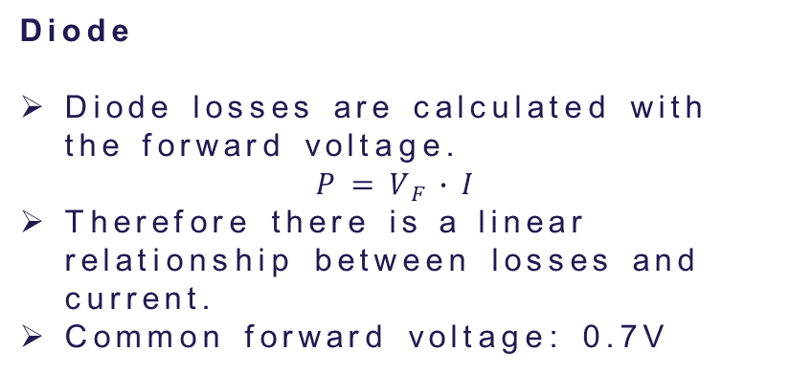
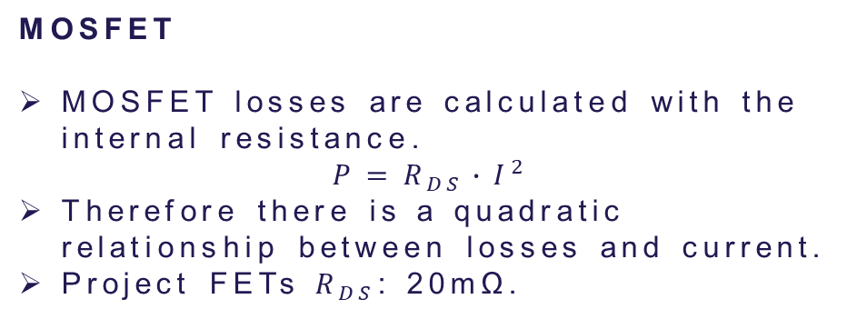
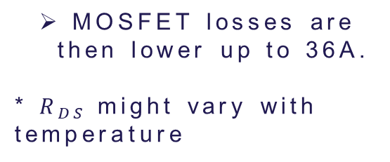
Why are there more losses in diodes than MOSFETs
Diode
Diode losses are calculated with the forward voltage.
$$P=V_{F}∙I$$
Therefore there is a linear relationship between losses and current.
Common forward voltage: 0.7V
MOSFET
MOSFET losses are calculated with the internal resistance.
$$P=R_{DS}∙I^{2}$$
Therefore there is a quadratic relationship between losses and current.
Project FETs $R_{DS}$: 20mΩ.
MOSFET losses are then lower up to 36A.
* $R_{DS}$might vary with temperature

Slide 4
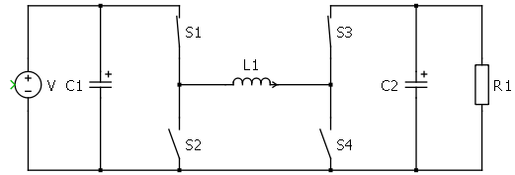
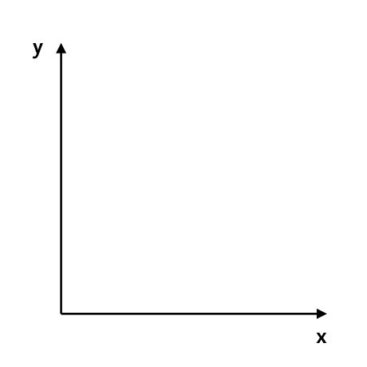


DCM
MOSFETs do not prevent reverse current like a diode would.
DCM mode is never reached when working with the 4 transistors.
Instead current would be negative through the inductor.
$$I_{L}$$
$$t$$

Slide 5
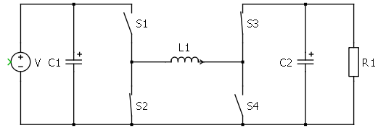
DCM
MOSFETs do not prevent reverse current like a diode would.
DCM mode is never reached when working with the 4 transistors.
Instead current would be negative through the couil.
$$I_{L}$$
$$t$$

Slide 6
DCM
MOSFETs do not prevent reverse current like a diode would.
DCM mode is never reached when working with the 4 transistors.
Instead current would be negative through the couil.
$$I_{L}$$
$$t$$

Slide 7
DCM
MOSFETs do not prevent reverse current like a diode would.
DCM mode is never reached when working with the 4 transistors.
Instead current would be negative through the couil.
$$I_{L}$$
$$t$$

Slide 8
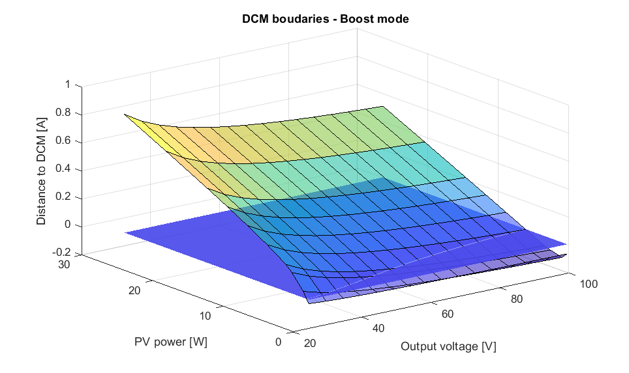
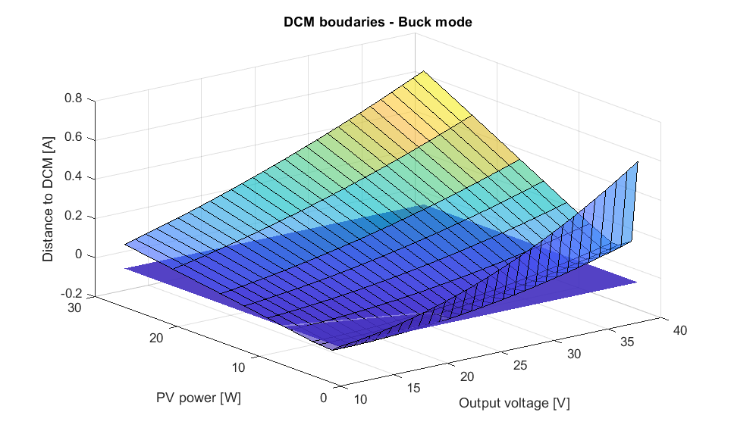
DCM
DCM mode depends on output voltage and power generated.

Slide 9
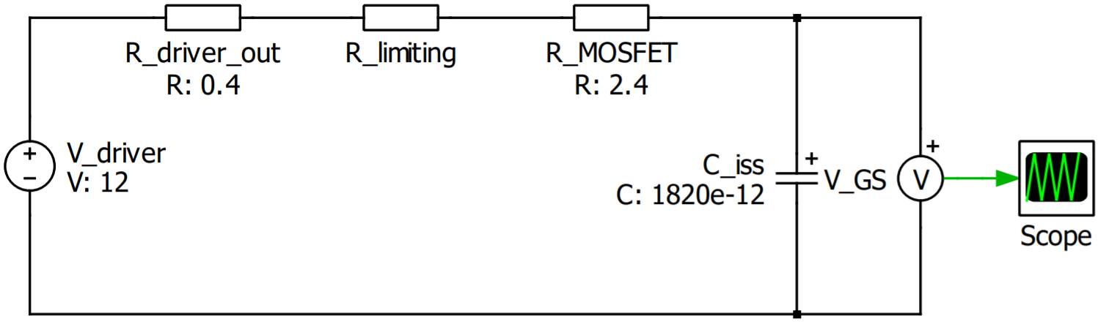

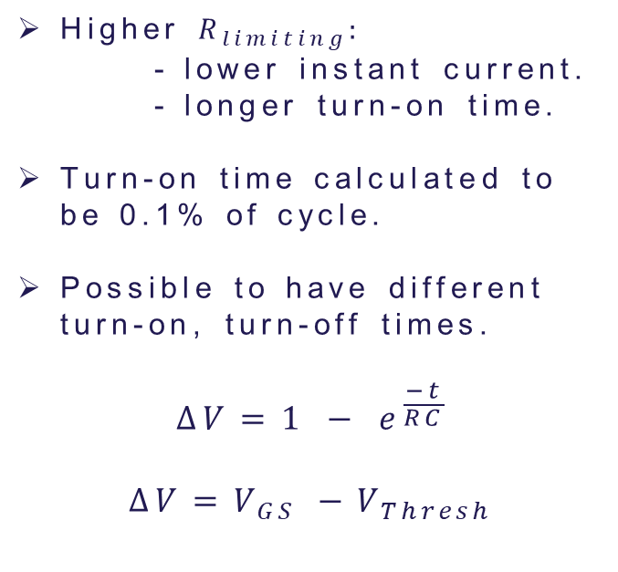
Limiting resistance
OUT H
$$R_{limiting}$$
Higher $R_{limiting}:$
- lower instant current.
- longer turn-on time.
Turn-on time calculated to be 0.1% of cycle.
Possible to have different turn-on, turn-off times.
$$∆V=1 − e^{\frac{−t}{RC}}$$
$$∆V=V_{GS} −V_{Thresh}$$
PWM
DRV
OUT L

Slide 10
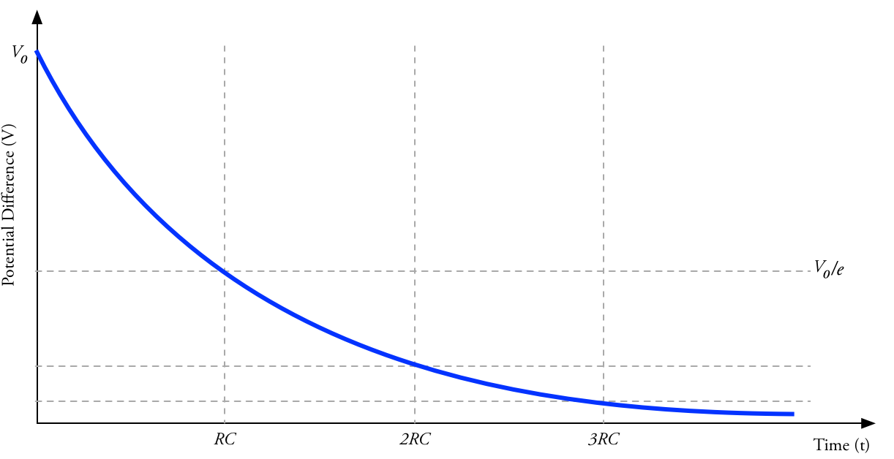





Discharging resistor
$$∆V=e^{\frac{−t}{RC}}$$
$$∆V=V_{GS} −V_{final}$$
$$R_{discharge}$$
$$C_{iss}$$
$$C_{in}$$
$$R_{discharge}$$

Slide 11

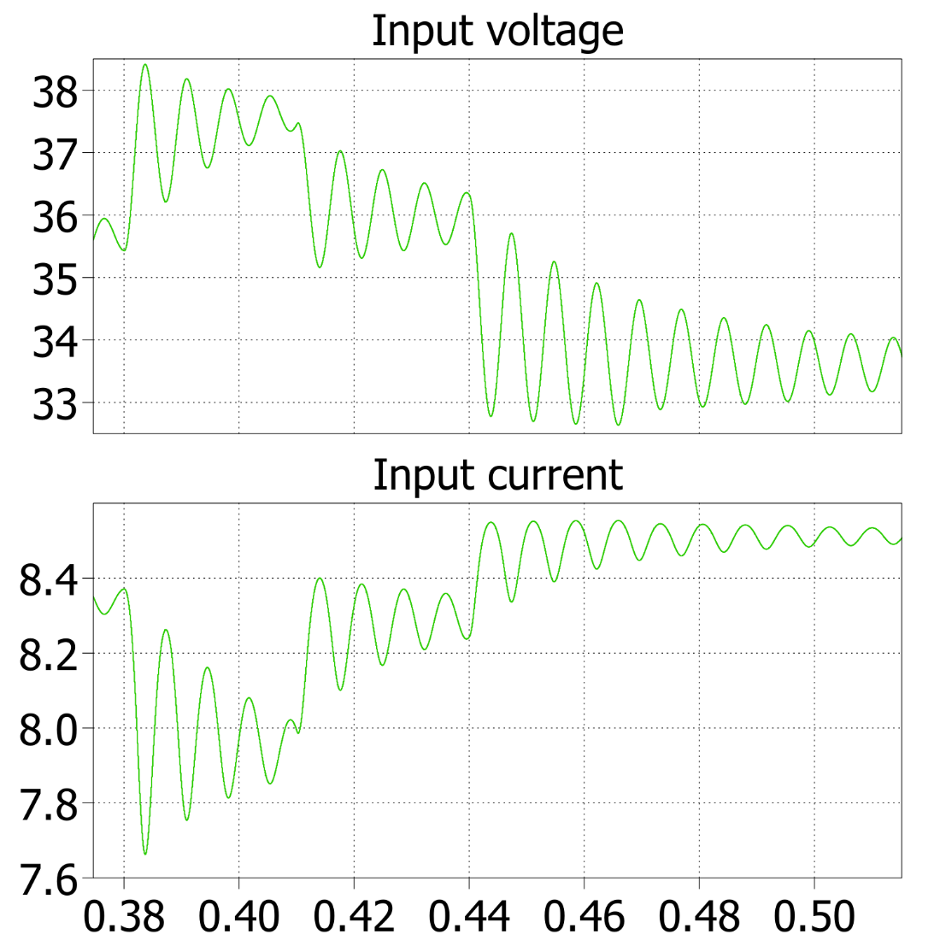
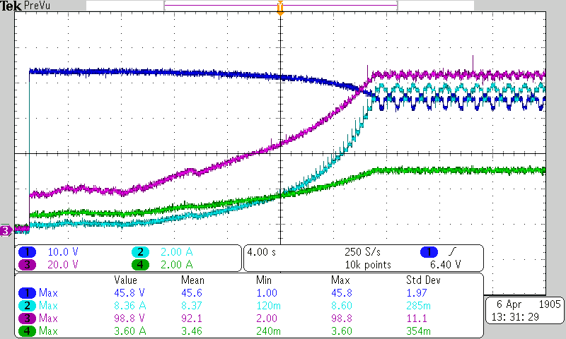
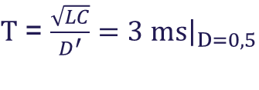
MPPT – Running frequency
Low frequency will lead to low reaction speed and oscillations
High frequency increases computational requirements
The system has a specific time constant (Tau) and having an MPPT faster than Tau is a waste of resources which can lead to instabilities as the variables are read during transients.
$Τ$ = $\frac{\sqrt{LC}}{D^{′}}=3 ms{\left.​\right|}_{D=0,5}$
Duty cycle is updated
Every 3 MPPT periods, which is 30 ms at 100 Hz
Oscillations of the system start-up (when the perturbation step is higher) working at 100 Hz. Working at a higher frequency would lead to too early measurements.
10 Hz MPPT
oscillations

Slide 12
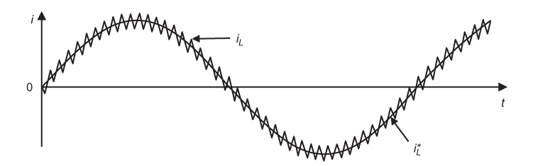
Hardware current sensor filtering
Different frequencies for different goals:
50 Hz → Low frequency allows reliable MPPT information.
80 kHz → In case a current controller is desired to be implemented, full sensor’s bandwidth is also available.
Further filtering can be achieved
through software
Hysteresis current control,
example of current control
that requires full bandwidth.
Predictive Control of Power Converters and Electrical Drives. P. Cortes. 2012

Slide 13
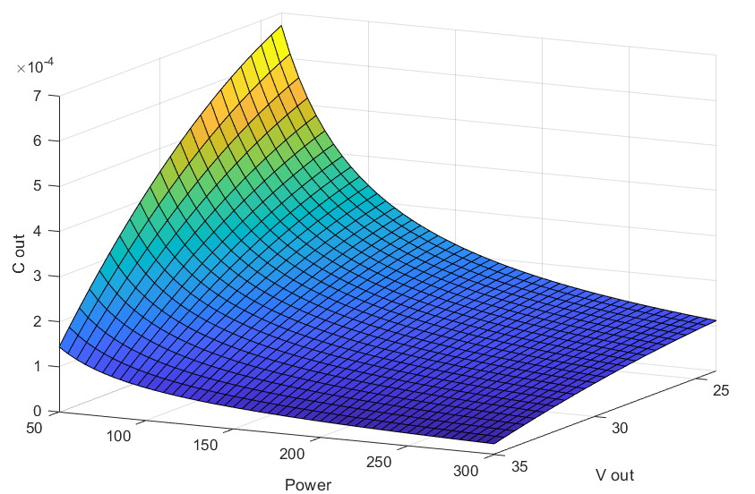
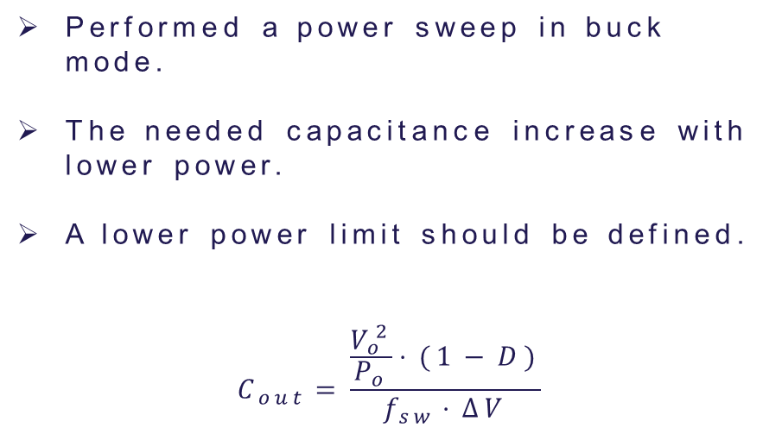
Output capacitor sizing EVERYTHING IS WRONG
Performed a power sweep in buck mode.
The needed capacitance increase with lower power.
A lower power limit should be defined.
$$C_{out}=\frac{\frac{V_{o}^{2}}{P_{o}}⋅(1−D)}{f_{sw}⋅ΔV}$$

Slide 14
Switching frequency – Maybe it is redundant to say it twice¿?
Switching frequency increase:
Switching losses increase.
Component size decrease.
Higher losses, lower cost.
Switching frequency decrease:
Switching losses decrease.
Component size increase.
Lower losses, higher cost.
RT-box would have to support the chosen frequency.

Slide 15
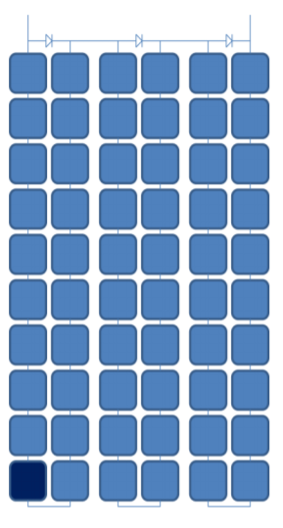
Bypass diodes vs MICs – Consider revising
Single bypass diode protects one sub-string ($≃$20 cells)
If high current flows through shaded cell → Power is consumed instead of produced!
Avoid hot-spots because the power consumed by the cell heats it up.
$≃$20% irradiance difference → bypass diode ON
Higher power losses than with MICs
Sub-string

Slide 16
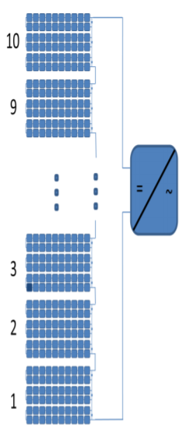
Bypass diodes vs MICs - Consider revising
Why using MICs improves power extraction?
Demonstration example: shaded cell at 80% irradiance
1st option: Bypass diode ON → 9*10% + 1*6.6% = 96.6%
2nd option: Reduce current to 80%→ 80% of full power
3rd option: MPPT tracker → 9*10% + 1*8% = 98%
Using MICs in each PV module → Increases power by 1.4%

Slide 17
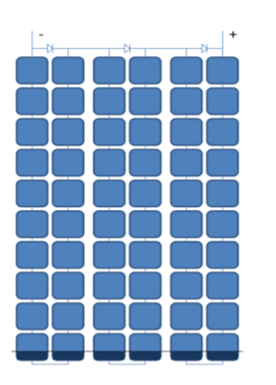
Bypass diodes vs MICs - Consider revising
Why using MICs improves power extraction?
Demonstration example: 30% shaded region
1st option: Bypass diodes ON → 9*10% + 1*0% = 90%
2nd option: Reduce current to 70%→ 70% of full power
3rd option: MPPT tracker → 9*10% + 1*7% = 97%
Using MICs in each PV module → Increases power by 7%

Slide 18
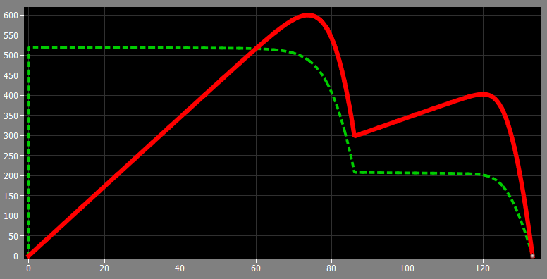
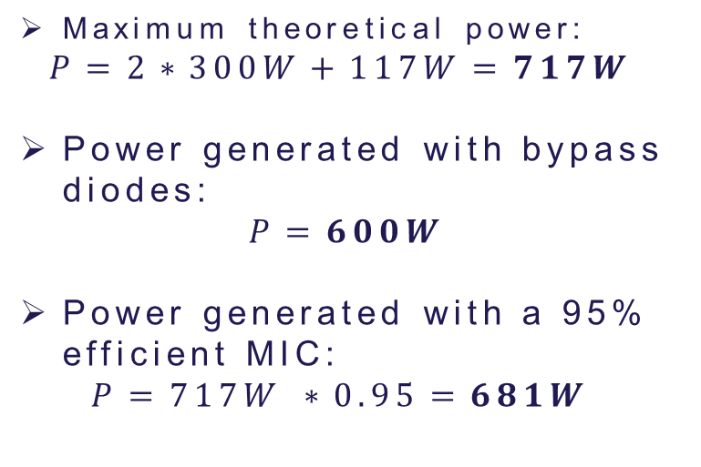
MIC advantage over bypass diode - Consider revising
Power generated in a 3 panel array with ideal bypass diodes.
2 panels 1000 W/m2.
1 panel 400 W/m2 (shaded).
25ºC.
Maximum theoretical power:
$$P=2∗300W+117W=717W$$
Power generated with bypass diodes:
$$P=600W$$
Power generated with a 95% efficient MIC:
$$P=717W ∗0.95=681W$$

Slide 19
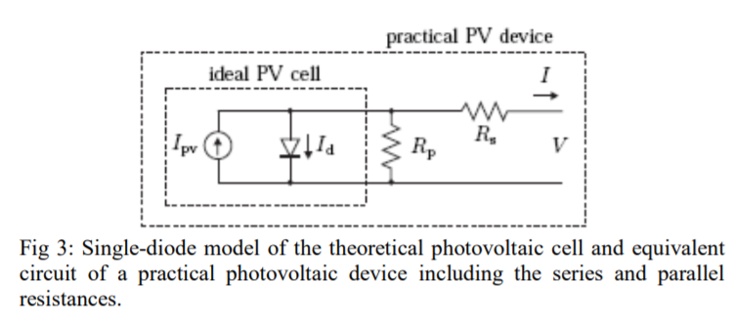
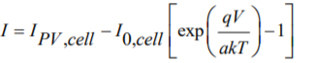
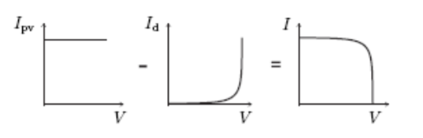
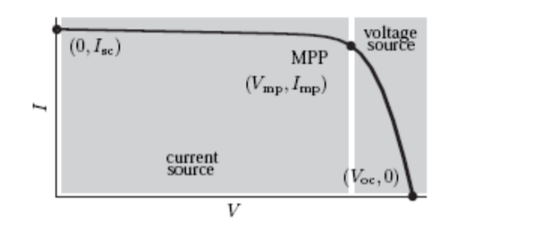
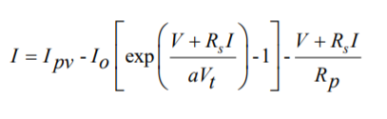
Limitations of single diode PV model
ideal
practical
Not enough with the ideal cell model to define the I-V characteristics of a solar panel because it is an array of series connected cells so it’s necessary to include Rs and Rp!

Slide 20
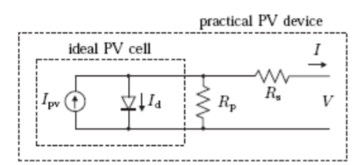
Limitations of single diode PV model
Rs → sum of several structural resistances of the PV panel.
Rp → due to the leakage current of the p-n junction and depends on the fabrication method of the cell.
Rp has very high value and Rs very low value (in some cases can be neglected)

Slide 21
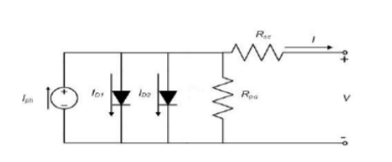
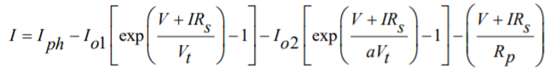
Limitations of single diode PV model
Double diode model:
Extra diode in parallel included to provide an EVEN more accurate I-V characteristic curve
“This model considers the difference in flow of current at low current values due to charge recombination in the semicondictor’s depletion región” (DON’T GET THIS :/)
Higher accuracy with this model BUT increase difficulty to solve the equation → Single diode model is preferred!

Slide 22
Another MPPT algorithm: Constant voltage
Pros:
Using only a voltage sensor.
Open loop control.
Contras:
The method can’t handle a change in environmental condition (temperature, partial shading). ¿?
Notes:
with strong temperature fluctuation the assumption of linear dependence is no longer valid
For a partial shaded PV panel the P-V curve has got multiple local maxima and the method can‘t handle this

Slide 23
Another MPPT algorithm: Fuzzy logic control – Remember to explain to the group
Pro:
inputs can be imprecise
not needing an accurate mathematical model
handling nonlinearity
performing well under varying environmental condition
Contra:
The method can’t handle a change in environmental condition (temperature, partial shading).
Notes:
with strong temperature fluctuation the assumption of linear dependence is no longer valid
For a partial shaded PV panel the P-V curve has got multiple local maxima and the method can‘t handle this

Slide 24
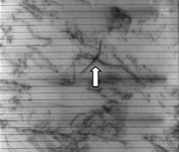
Why bidirectional ?
Extracting and injecting current from the PV panel
Injection current:
Because of electroluminescence
the PV panel emits light for
detection microcracks
Microcracks:
The orientation is important for
causing power losses.
The most critical one is parallel to the
busbars. OUT OF SCOPE¿?
Electroluminescence image of a PV panel [1]
[1]https://www.sensovation.com/
com/Applications/Photovoltaic

Slide 25
When does the MIC make sense in terms of cost/energy/efficiency?
Optimal power production efficiency with missmatches
System cost
System cost per watt
Based on a 10 kW series-string MC, or MI PV systems.
One MC or MI for one PV panel
Reference: Efficiency and Cost Trade-Offs for Designing Module Integrated Converter Photovoltaic Systems

Slide 26
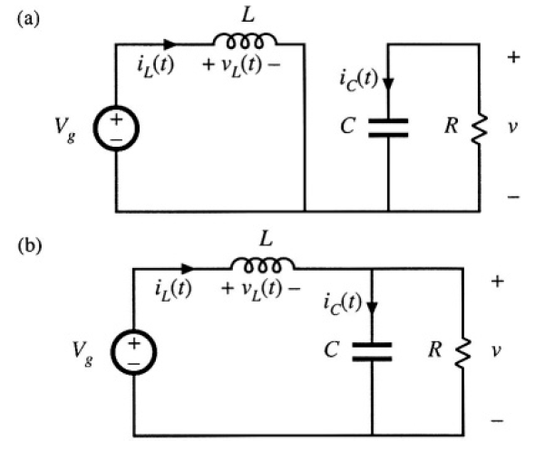
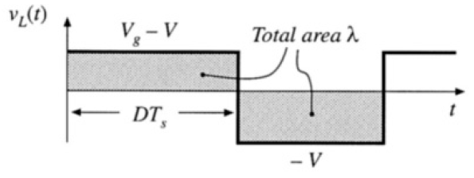
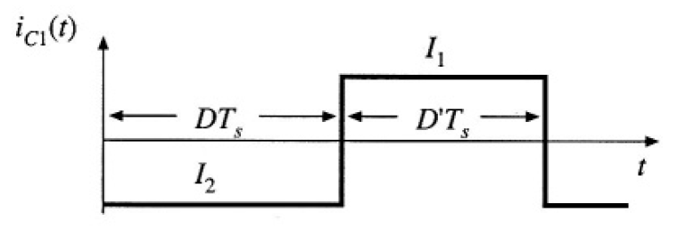

Passive components’ calculations
$$C=\frac{∆Q}{∆V}$$

Slide 27
Errors in the report
non inverting buck boost converter is wrong as the ground connection is missing, this happens at least three times in different figures (2.3, 2.4 and 3.1).
Wrong legend in ‘valg’ mapping diagram (Figure 5.2).
Calculation of maximum mics (equation 2.2) is wrong. Refer to presentation slide where it’s correct.

